Slide 1
CMMCAWorkshop
Computational Mathematics Modeling in Cancer Analysis
Region-aware Diagnosis of Clinically Significant Prostate Cancer via
Semi-supervised Learning Segmentation
Guantian Huang¹, Shouliang Qi¹, Wei Qian¹, Xin Shi², and Dianning He^{2()}
¹ College of Medicine and Biological Information Engineering, Northeastern University, Liaoning, China
² School of Health Management, China Medical University, Liaoning, China

Slide 2
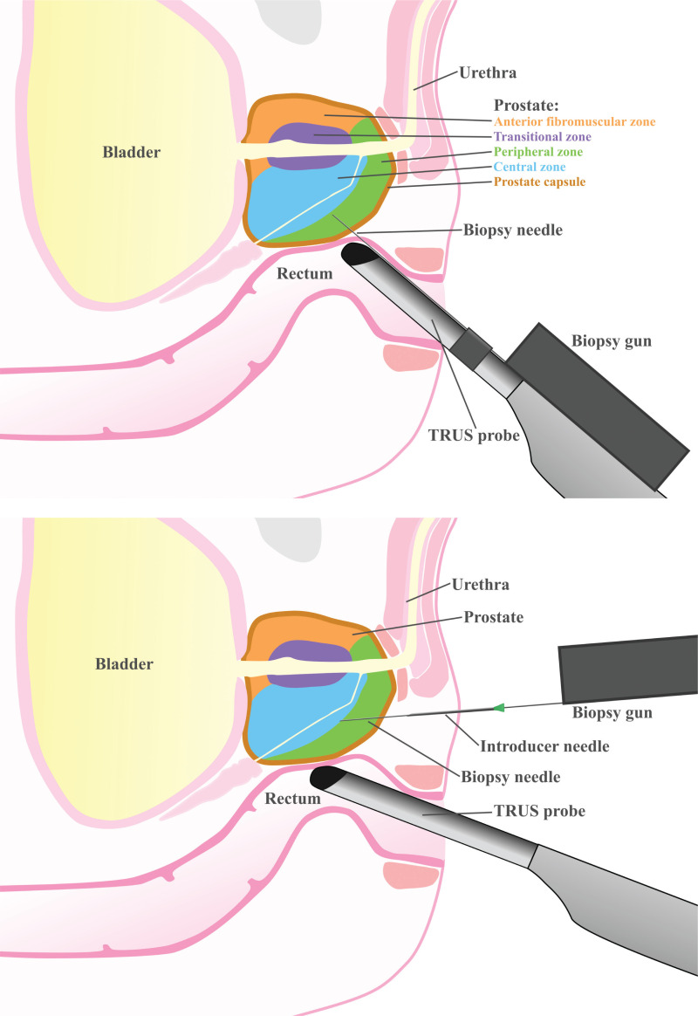
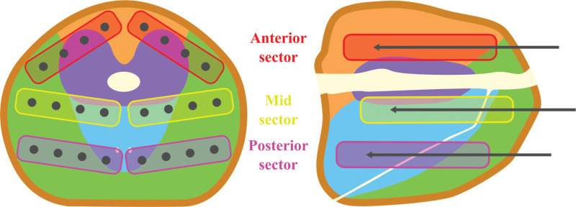
CMMCAWorkshop
Computational Mathematics Modeling in Cancer Analysis
Background
Prostate cancer is one of the most common malignant tumors in men.
Biopsy remains the gold standard for diagnosis.
Multiparametric MRI (mpMRI) represents a noninvasive imaging modality with significant advances in diagnostic capability.
Prostate Imaging Reporting and Data System (PI-RADS) v2.1 provides an internationally recognized standardized framework for structured radiological assessment.
Gravestock P, Shaw M, Veeratterapillay R, et al. Prostate Cancer Diagnosis: Biopsy Approaches. In: Barber N, Ali A, editors. Urologic Cancers [Internet]. Brisbane (AU): Exon Publications; 2022 Sep 12.

Slide 3
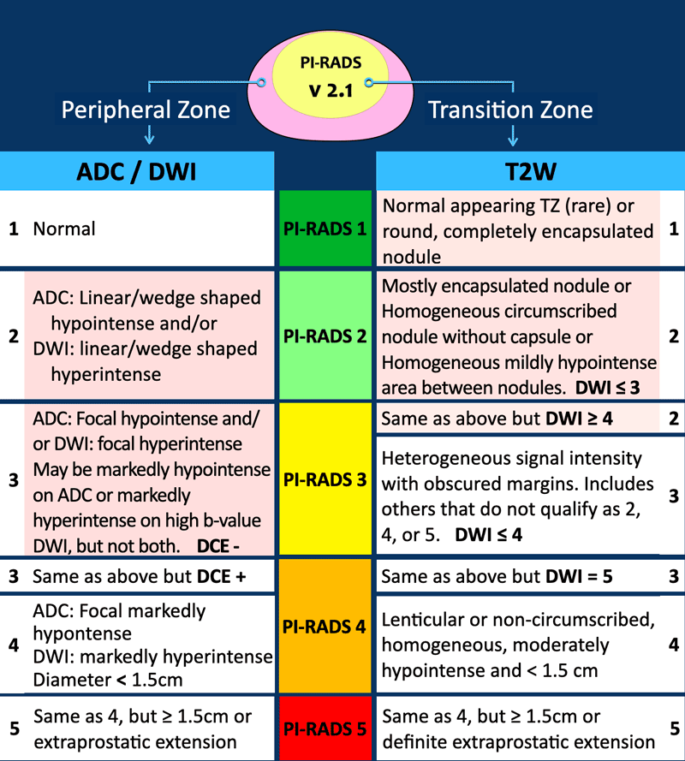
CMMCAWorkshop
Computational Mathematics Modeling in Cancer Analysis
Background
Clinical workload and inter-reader variability lead to insufficient quantitative imaging analysis.
Therefore, a quantitative AI-assisted diagnostic system is urgently needed.
PI-RADS v2.1 recommends evaluating lesions in the context of prostate zones (e.g., PZ, TZ).
From: https://radiologyassistant.nl/abdomen/prostate/prostate-cancer-pi-rads-v2-1

Slide 4
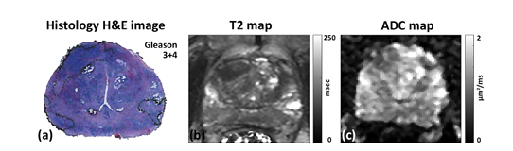
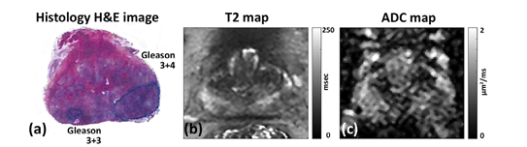
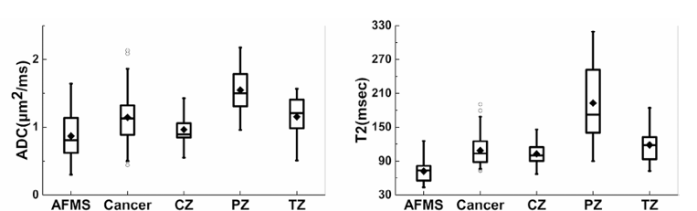
CMMCAWorkshop
Computational Mathematics Modeling in Cancer Analysis
Background
Clinical Imaging Findings: ADC/T2 perform best in the peripheral zone, but nearly fail in the central zone and anterior fibromuscular stroma.
Limitation of single indicators: diagnostic performance varies significantly across regions.
Value of regional priors: incorporating anatomical zone knowledge enhances model adaptation to heterogeneity.
Gap in Current AI Models: Current AI models seldom model intra-prostate regional heterogeneity.
Reference: Chatterjee A, He D, Fan X, et al., Performance of Ultrafast DCE-MRI for Diagnosis of Prostate Cancer. Academic Radiology 2018, 25 (3), 349-358.

Slide 5
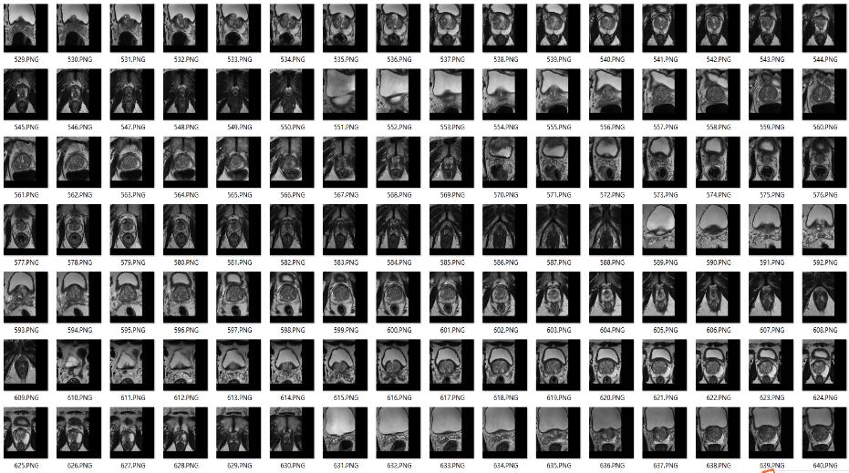

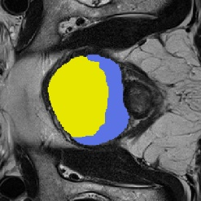
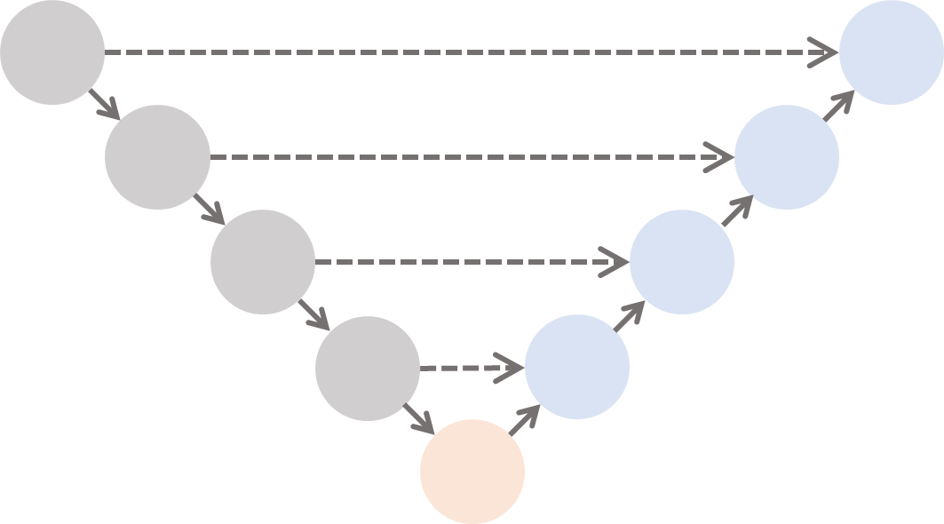
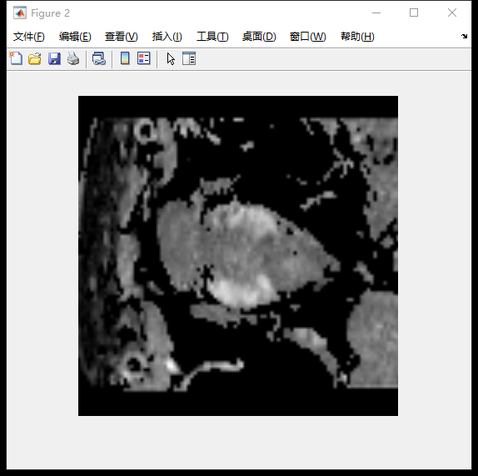

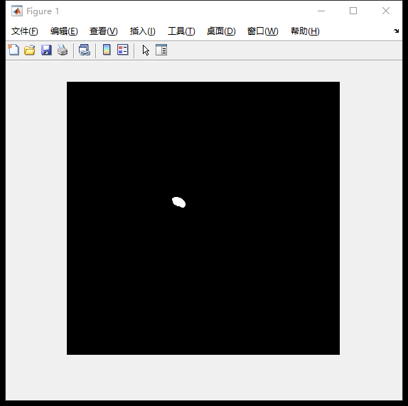
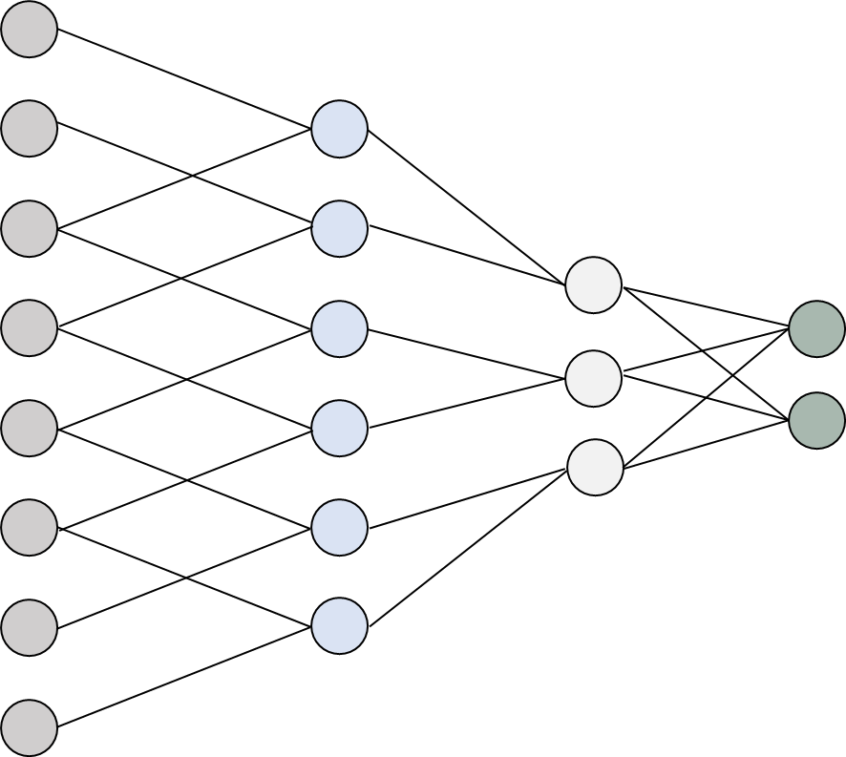
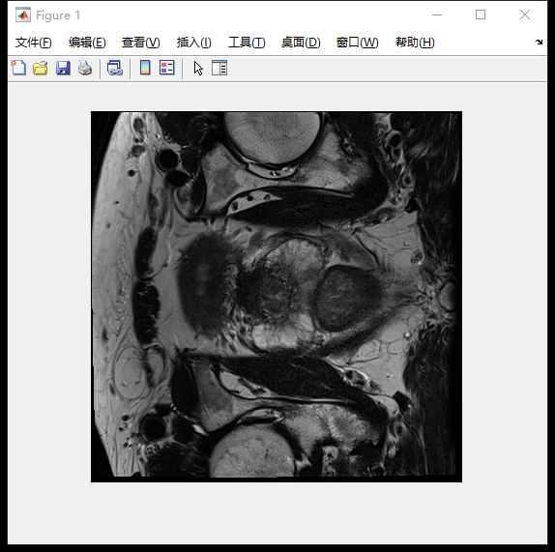
CMMCAWorkshop
Computational Mathematics Modeling in Cancer Analysis
Purpose
Goal: Leverage prostate anatomical regions as priors knowledge to boost diagnosis.
Pain point: Manual zone delineation is time-consuming and variable across readers.
Strategy: Exploit abundant unlabeled ≫ labeled data via semi-supervision to get prostate zones.
Innovation: Add prostate anatomical regions into Standard AI Diagnostic Workflow
AI Segment
Moedl
Experts
Training
≫
Unlabelled
Labelled
Prior Knowledge
Standard Diagnostic Workflow
+
Classification
Network
Prostate cancer Diagnosis
MpMRI Sequences
ROI

Slide 6
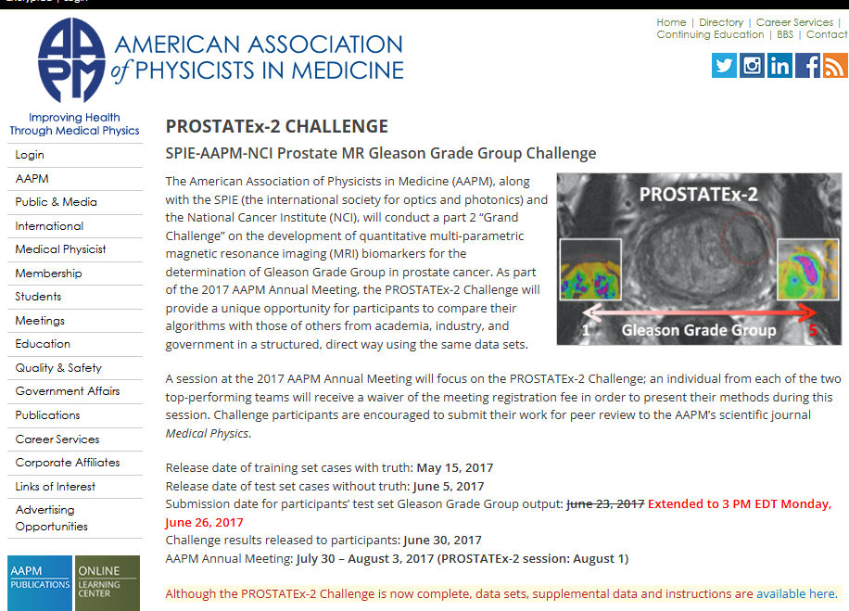
CMMCAWorkshop
Computational Mathematics Modeling in Cancer Analysis
Dadaset
Dataset: ProstateX
Access from:
https://www.cancerimagingarchive.net/collection/prostatex/
Labeled patients:98
Unlabeled patients: 246
Biopsy-confirmed patients: 112

Slide 7
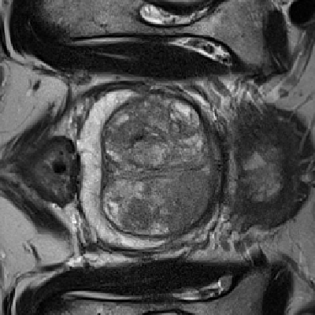
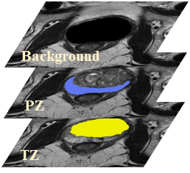
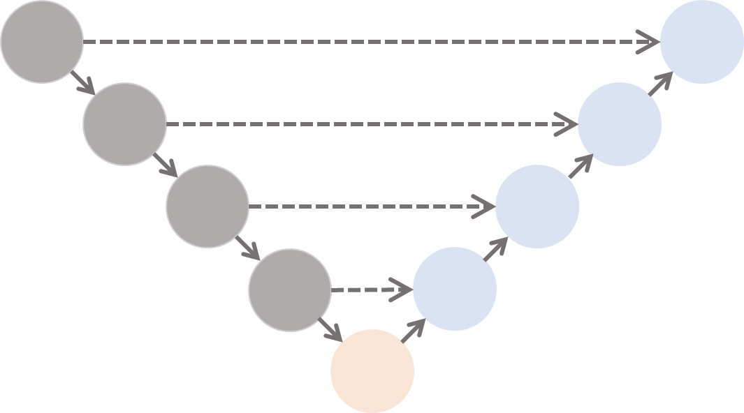
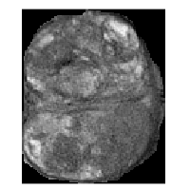
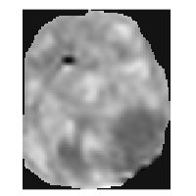
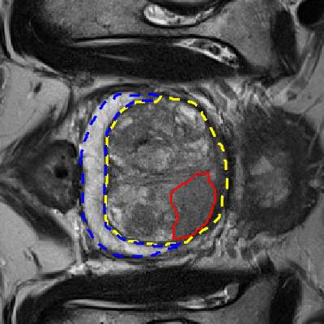
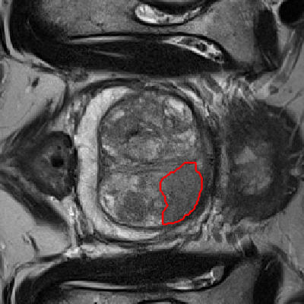
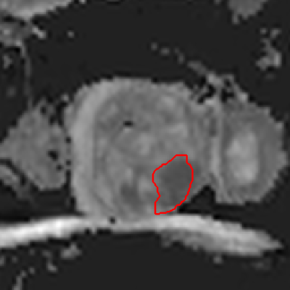

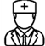

CMMCAWorkshop
Computational Mathematics Modeling in Cancer Analysis
Methods
Overview Framework
Stage I
Stage III
Segmentation Network
T2
Stage II
Location
Confirmation
Location
CsPCa
Assistant Network
＋
Registration
NcsPCa
T2
ADC
Transition Zone
or
Peripheral Zone
ROI
Main network

Slide 8
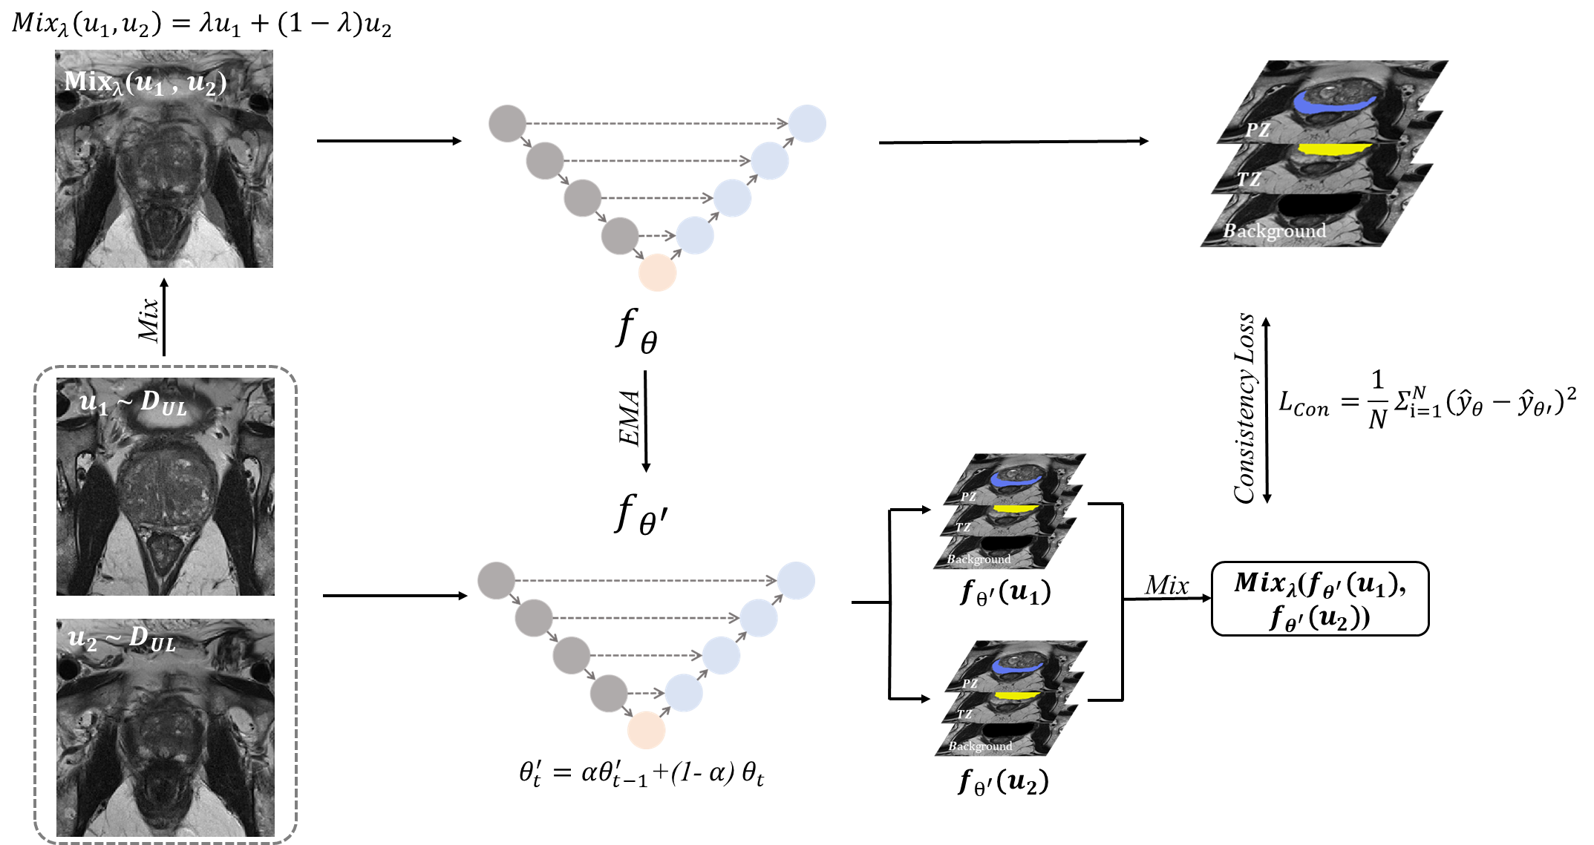
CMMCAWorkshop
Computational Mathematics Modeling in Cancer Analysis
Methods
Semi-supervised Learning Segmentation Framework

Slide 9
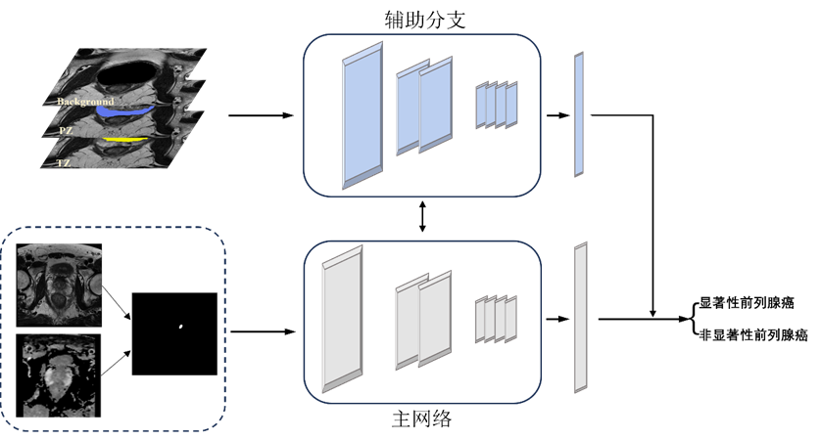
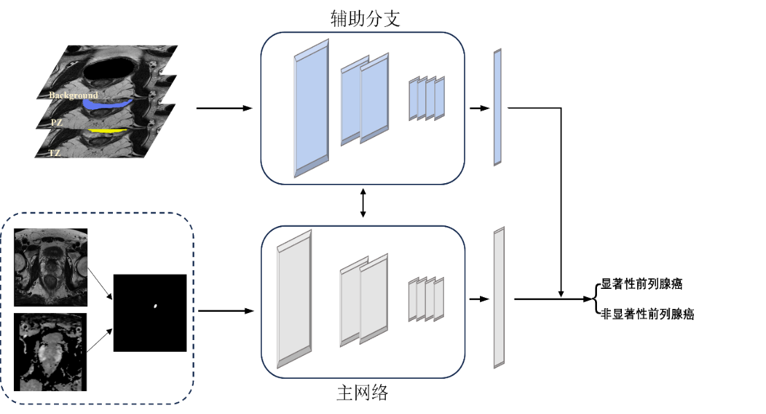
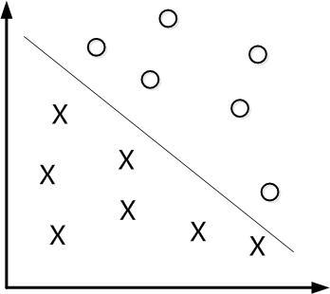
CMMCAWorkshop
Computational Mathematics Modeling in Cancer Analysis
Methods
Classfication Framework
Machine Learning
Assistant
PyRadiomics
PyRadiomics
Deep Learning
Assistant Network
Sigmoid
＋
$$\hat{F}=a⋅F_{main}+\left(1−a\right)⋅F_{ass}$$
Main Network

Slide 10
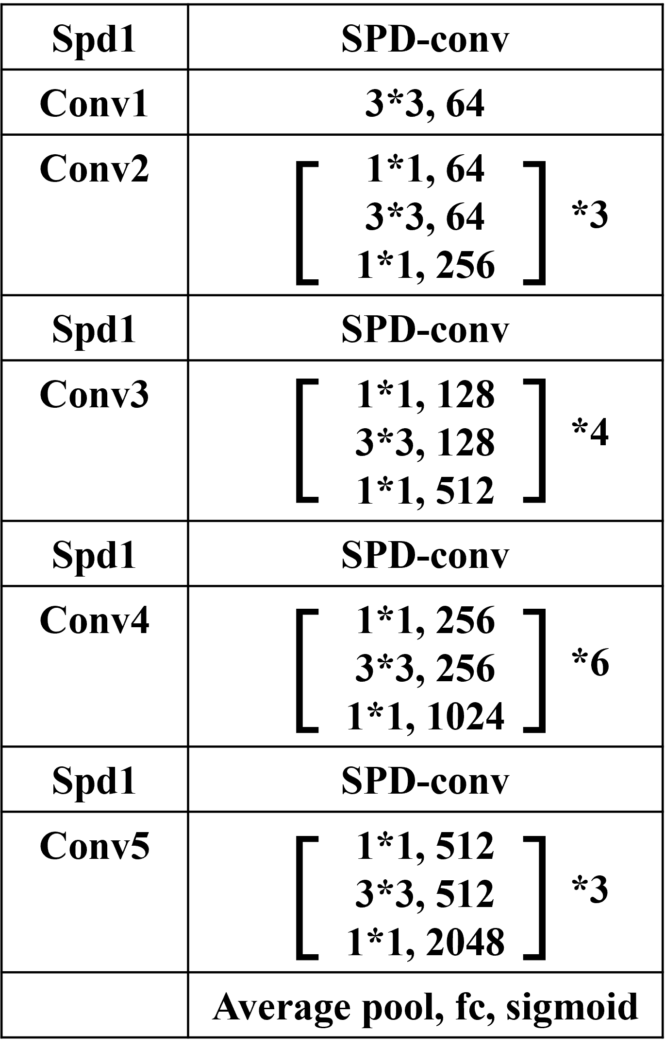
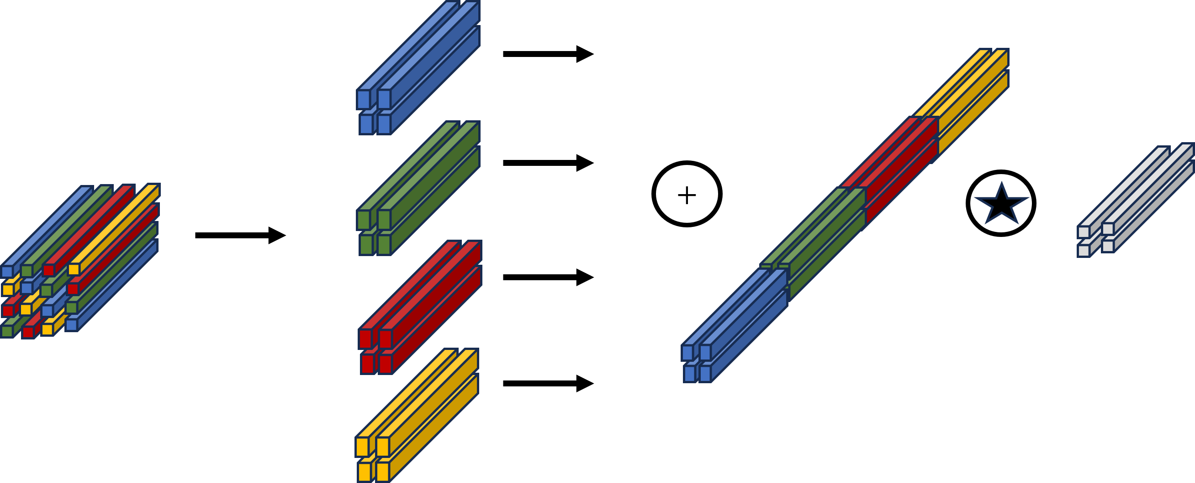
CMMCAWorkshop
Computational Mathematics Modeling in Cancer Analysis
Methods
ClassficationFramework
SPD-ResNet 50
SPD-conv
Input
SPD-conv
SPD-conv
SPD-conv
SPD-conv
×3
×4
×6
×3
Conv1
Conv2
Conv3
Conv4
Conv5

Slide 11
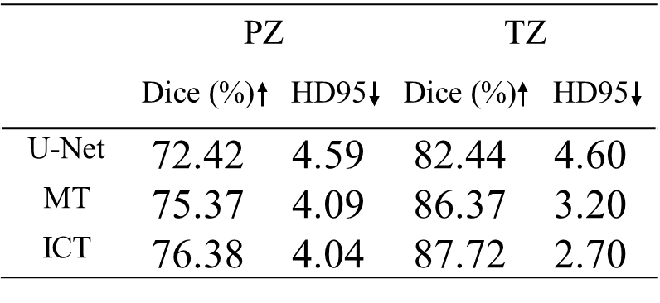
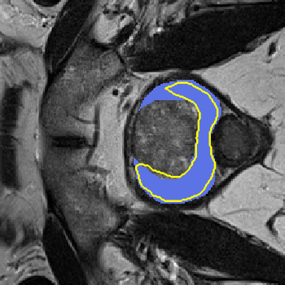
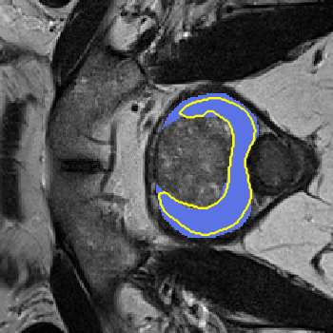

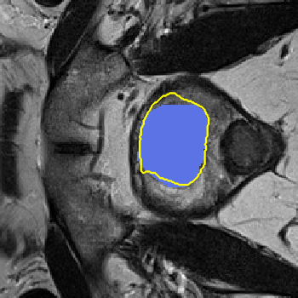
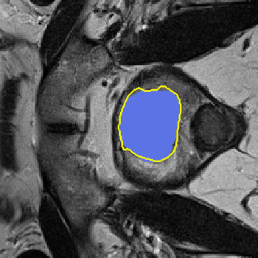

CMMCAWorkshop
Computational Mathematics Modeling in Cancer Analysis
Results
Supervised
MT
ICT
PZ
MT = Mean Teacher
ICT = Interpolation consistency training
TZ
Ground Truth
Prediction

Slide 12
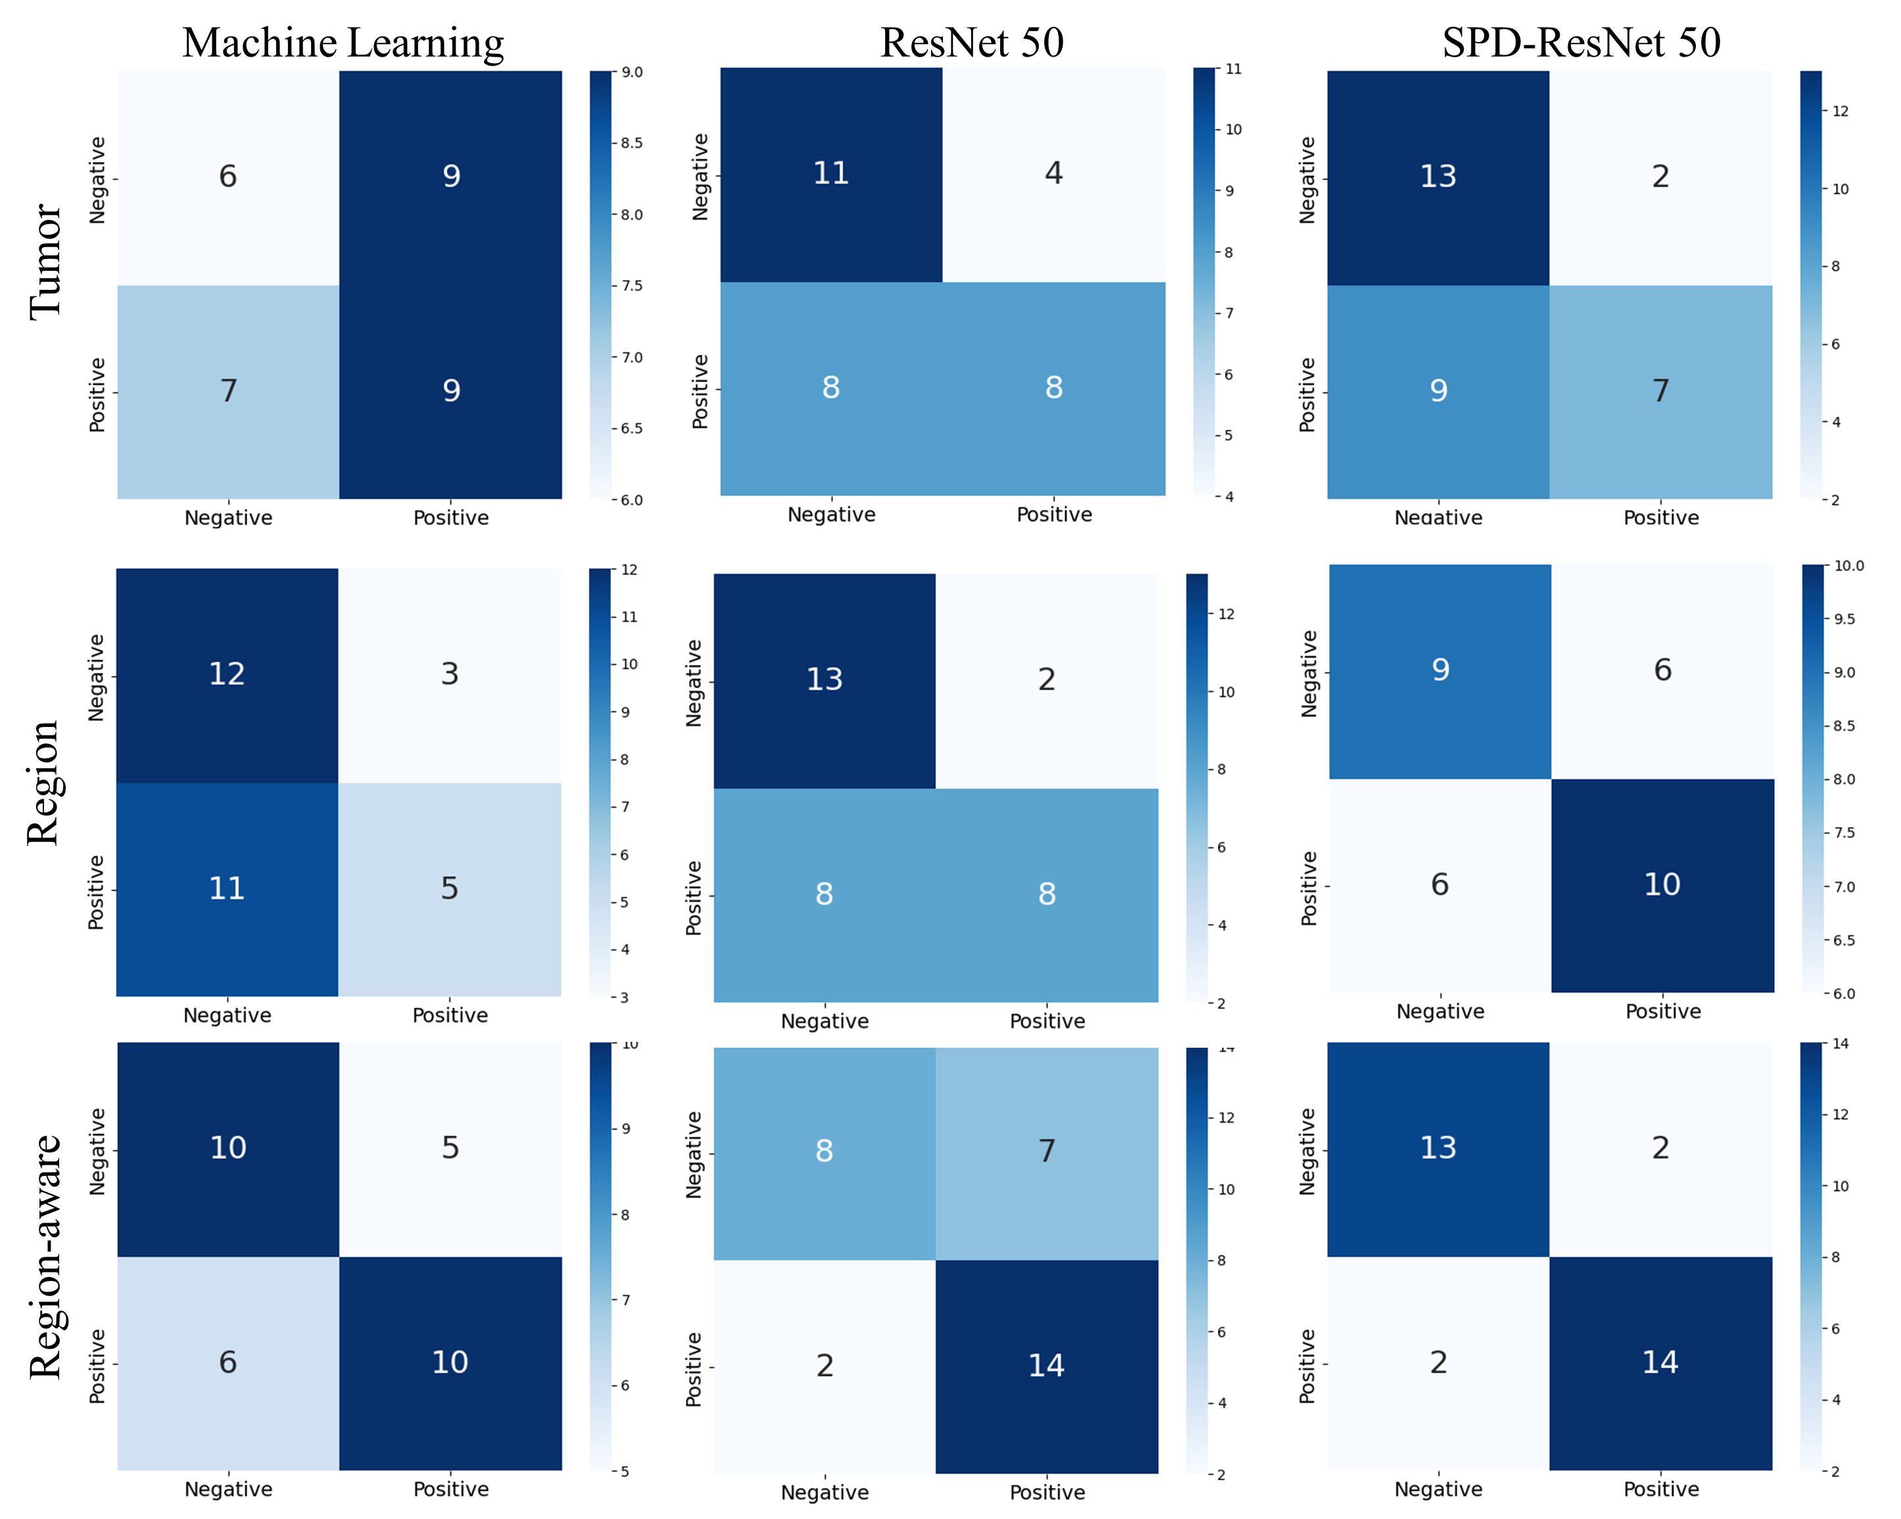
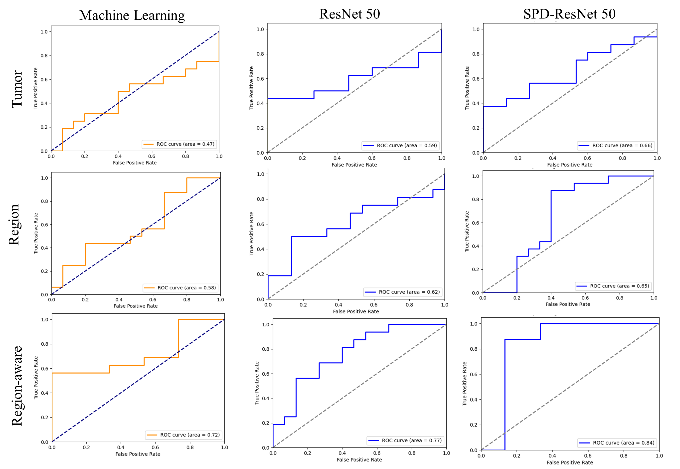
CMMCAWorkshop
Computational Mathematics Modeling in Cancer Analysis
Results

Slide 13
CMMCAWorkshop
Computational Mathematics Modeling in Cancer Analysis
Results
Comparison between using tumor information alone and incorporating prior knowledge.
 |  | Accuracy | Precision | F1 Score | Sensitivity | Specificity | AUC
ML | Tumor | 48.39 | 50.00 | 52.94 | 56.25 | 40.00 | 0.47
 | Region-aware | 64.52 | 66.67 | 64.52 | 62.50 | 66.67 | 0.72
 | Improvement | 33.33% | 33.34% | 21.87% | 11.11% | 66.68% | 53.19%
Resnet | Tumor | 61.29 | 66.67 | 57.14 | 50.00 | 73.33 | 0.59
 | Region-aware | 70.97 | 66.67 | 75.68 | 87.50 | 53.33 | 0.77
 | Improvement | 15.79% | 0% | 32.45% | 75% | -27.27% | 30.51%
SPD-Resnet | Tumor | 64.52 | 77.78 | 56.00 | 43.75 | 86.60 | 0.66
 | Region-aware | 87.10 | 87.50 | 87.50 | 87.50 | 86.67 | 0.84
 | Improvement | 35.00% | 12.50% | 56.25% | 100% | 0.08% | 27.27%
Only prior knowledge.
 | Accuracy | Precision | F1 Score | Sensitivity | Specificity | AUC
ML | 54.84 | 41.67 | 52.94 | 31.25 | 80.00 | 0.58
ResNet | 64.52 | 80.00 | 61.54 | 50.00 | 86.67 | 0.62
SPD-ResNet | 61.29 | 62.50 | 62.50 | 62.50 | 60.00 | 0.65

Slide 14
CMMCAWorkshop
Computational Mathematics Modeling in Cancer Analysis
Key Findings & Insights
Structural anatomy improves performance: Incorporating anatomical information into the diagnostic pipeline significantly enhances prostate cancer classification.
Generalizable approach: Region-aware analysis is not limited to prostate cancer; it can be applied to other diseases where anatomical context matters (e.g., cardiac disease).
Anatomy as a modality: Beyond imaging + clinical data, anatomical structure itself should be treated as a valuable modality that boosts diagnostic accuracy.

Slide 15
CMMCAWorkshop
Computational Mathematics Modeling in Cancer Analysis
Limitations
Small sample size: Current dataset remains relatively limited, reducing robustness of conclusions.
Simplified classification: Study focused only on binary classification (clinically significant vs. non-significant), not more complex diagnostic tasks.
Future Directions
Larger datasets: Expand data collection to improve robustness and generalizability.
Gleason grading: Extend method to support Gleason grading, a clinically relevant task.
Multimodal integration: Combine region-aware analysis with broader multimodal clinical data to advance prostate cancer diagnosis.

Slide 16
CMMCAWorkshop
Computational Mathematics Modeling in Cancer Analysis
Thanks
Guantian Huang¹, Shouliang Qi¹, Wei Qian¹, Xin Shi², and Dianning He^{2()}
Email: huanggt@mails.neu.edu.cn
Wechat: hgt20000307
TEL： +86 131 4782 8452

